Slide 1
Wi-Fi Protected Access(WPA)
B.R.SREEPADARAJA

Slide 2
introduction to WPA
Definition of WPA (Wi-Fi Protected Access)
A security protocol designed to protect wireless networks
A successor to the WEP (Wired Equivalent Privacy) prot
Purpose of WPA
To provide enhanced security to wireless networks
To address the vulnerabilities of WEP
History of WPA
Introduced in 2003 by the Wi-Fi Alliance
WPA2 introduced in 2004 as an improvement over WPA
Importance of network security in wireless networking
Risks associated with wireless networks
Need for encryption and authentication in wireless networks

Slide 3
How WPA Works
Overview of the WPA security architecture
Use of encryption and authentication
Four-way handshake process
Encryption in WPA
Use of the Temporal Key Integrity Protocol (TKIP)
Key mixing and per-packet key generation
Authentication in WPA
Use of a pre-shared key (WPA-PSK) or 802.1x (WPA-Enterprise)
RADIUS (Remote Authentication Dial-In User Service) server for authentication in WPA-Enterprise
Advantages of WPA over WEP
Stronger encryption and authentication mechanisms
Use of dynamic keys instead of static keys

Slide 4
Temporal key
a temporal key is a secret encryption key that is generated dynamically and periodically changed to secure the data transmission.
The need for a temporal key arises from the vulnerabilities of using a static key for encryption, which can be compromised by an attacker who intercepts the key. By generating a new temporal key for each communication session, the security of the communication is improved.
In the Wi-Fi Protected Access (WPA) protocol, a temporal key is generated during the four-way handshake process between the wireless client and access point. The temporal key is used to encrypt data between the two devices during the current session.

Slide 5
Message Integrity Code
Message Integrity Code, which is a security mechanism used to ensure the integrity of a message being transmitted over a wireless network. The MIC is generated using an encryption algorithm and is appended to the message.
The need for MIC arises because wireless networks are vulnerable to attacks that can manipulate or modify the data being transmitted. This can lead to unauthorized access, data loss, or other security breaches.
y using a MIC, the receiver of the message can verify that the message has not been tampered with or modified during transmission. If the MIC value of the received message does not match the calculated value at the receiver, it indicates that the message has been altered, and the receiver can discard the message.

Slide 6
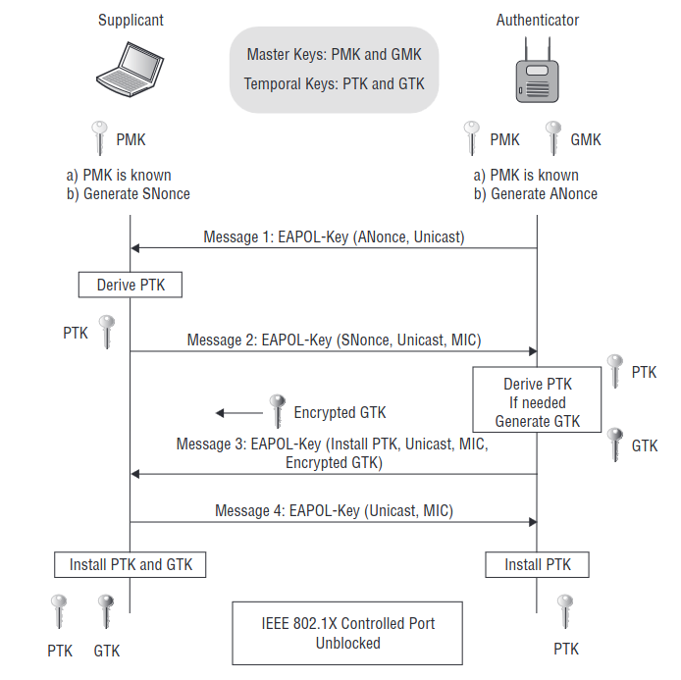
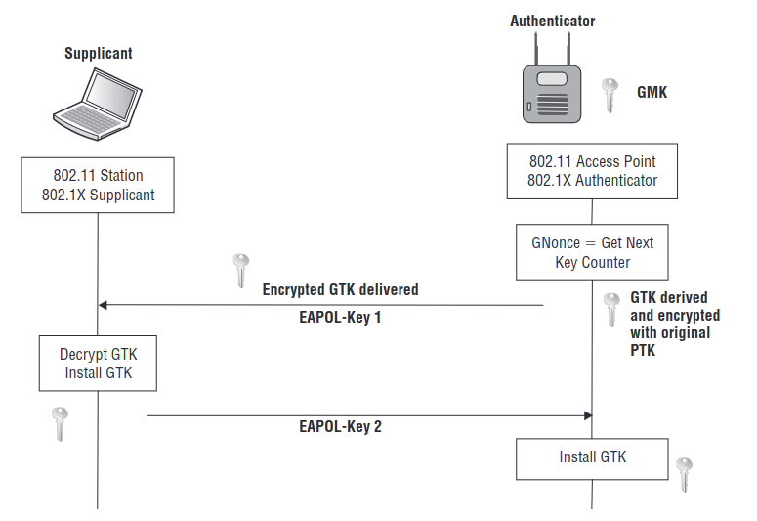
4 WAY-HANDSHAKE

Slide 7
PROCEDURE OF 4WAYHANDSHAKE
The 4-way handshake is the process used in Wi-Fi Protected Access (WPA) to authenticate clients and provide them with encryption keys for data communication. Here are the steps involved in the 4-way handshake:
The client sends an authentication request (ANonce) to the access point (AP) to start the process.
The AP responds with its own challenge (SNonce) and the Group Temporal Key (GTK) encrypted with the Pairwise Master Key (PMK).
The client receives the challenge and uses it, along with the PMK and the ANonce, to generate a Pairwise Transient Key (PTK). The PTK consists of a number of keys, including the Temporal Key (TK), the MIC Key (MK), and the encryption and integrity keys.
The client sends the AP a message containing its own challenge (ANonce), along with the MIC generated from the previous messages using the MK.
The AP receives the message and verifies the MIC. If the MIC is correct, it confirms the successful completion of the 4-way handshake and sends the GTK to the client encrypted with the TK.
The client receives the GTK and uses it to encrypt and decrypt multicast and broadcast traffic on the network.

Slide 8
TOTAL KEYS GENERATED
MSK(Master Session Key)
Key information that is jointly negotiated between the Supplicant & Authentication Server. This key information is transported via a secure channel from Authenticating Server to Authenticator.
DERIVATION FORMULA:-
MSK = PBKDF2(HMAC_SHA1, PSK, SSID, 4096, 256)
PMK-Pairwise Master Key:
PMK is derived from MSK seeding material. PMK is first 256bits (0-255) of MSK. It can be derived from an EAP method or directly from a Pre sharedKey(PSK).
DERIVATION FORMULA:-
PMK = PBKDF2(HMAC−SHA1, MSK,"PMK NAME", SSID, 4096, 256)
GMK-Group Master Key:
GMK is randomly created on Authenticator & refresh it in configured time interval to reduce the risk of GMK being compromised.
DERIVATION FORMULA:
GMK = PBKDF2(HMAC−SHA1, MSK,"GMK NAME", SSID, 4096, 256)

Slide 9
PTK-Pairwise Transient Key:(64 BYTES)
A value derived from PMK,Authenicator nonce(Anonce),Supplicant nonce(Snonce), Authenticator Address, Supplicant Address. This is used to encrypt all unicast transmission between client & an AP. PTK consist of 5 different keys
DERIVATION FORMULA:
PTK=PRF(PMK,ANONCE,SNONCE,AP-MAC,STA-MAC)
5 KEYS IN PTK
KCK-Key Confirmation Key-used to provide data integrity during 4 -Way Handshake & Group Key Handshake.(16 BYTES)
KEK – Key Encryption Key– used by EAPOL-Key frames to provide data privacy during 4-Way Handshake & Group Key Handshake.(16 BYTES)
Temporal Key – used to encrypt & decrypt MSDU of 802.11 data frames between supplicant & authenticator(16 BYTES)
Temporal MIC-1(8 BYTES)
Temporal MIC-2(8 BYTES)
GTK-Group Temporal Key:(32 BYTES)
GTK is used to encrypt all broadcast/multicast transmission between an AP & multiple client statsions. GTK is derived on Authenticator & sending to supplicant during 4-Way Handshake

Slide 10
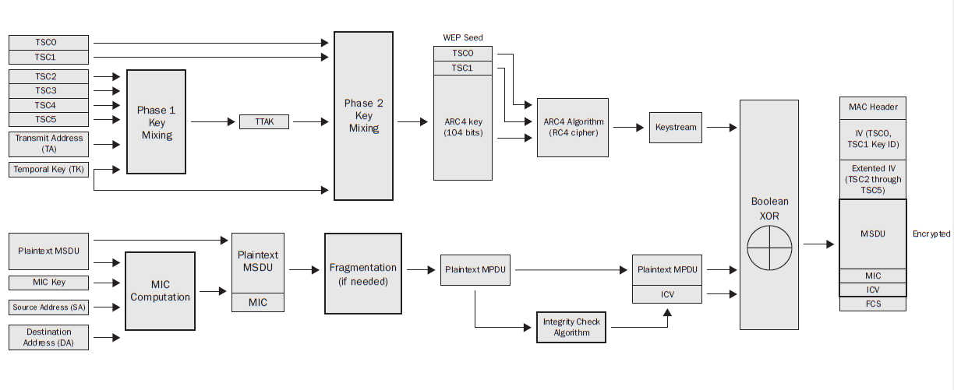
flow

Slide 11
procedure
TKIP starts with a 128-bit temporal key is a dynamically generated key that comes from a 4-Way Handshake creation process. This key is identical on the AP and client pair. The 128-bit temporal key can either be a pairwise transient key (PTK) used to encrypt unicast traffic or a group temporal key (GTK) used to encrypt broadcast and multicast traffic.
After the appropriate 128-bit temporal key (pairwise or group) is created, the two-phase key-mixing process begins. A 48-bit TKIP sequence counter (TSC) is generated and broken into 6 octets labeled TSC0 (least significant octet) through TSC5 (most significant octet). Phase 1 key mixing combines the 128-bit temporal key (TK) with the TSC2 through TSC5 octets of the TSC as well as the transmit address (TA). The TA is the MAC address of the transmitting 802.11 radio. The output of the Phase 1 key mixing is the creation of the TKIP-mixed transmit address and key (TTAK).
After the TTAK is generated, the Phase 2 key mixing can begin. Phase 2 key mixing combines the TTAK with the TSC0 and TSC1 octets of the TSC with the 128-bit TK. The output of the Phase 2 key mixing is referred to as the WEP seed. This WEP seed is then run through the ARC4 algorithm, and the keystream is created.

Slide 12
The WEP seed is represented as a WEP IV and 104-bit WEP key when fed into the ARC4 algorithm. You may often hear TKIP referenced as using a 48-bit IV. During the Phase 2 key mixing process, TKIP encodes the TSC value from the sender as a WEP IV and an extended IV. The encoding of the 48-bit TSC effectively creates a 48-bit IV.
TTAK = Phase 1 (TK, TA, TSC)
WEP seed = Phase 2 (TTAK, TK, TSC)

Slide 13
Message integrity code
TKIP uses a stronger data integrity check known as the message integrity code (MIC) to mitigate known forgery attacks against WEP.
The MIC can be used to defeat bit-flipping attacks, fragmentation attacks, redirection, and impersonation attacks.
The MIC is computed using the destination address (DA), the source address (SA), the MSDU priority, and the entire unencrypted MSDU plain- text data. After the MIC is generated, it is appended the end of the MSDU payload

Slide 14
Vulnerabilities of WPA
Despite being a more secure alternative to WEP, WPA also has some vulnerabilities.
Attackers can exploit these vulnerabilities to gain unauthorized access to the network.
Dictionary Attack
One of the most common attacks on WPA is a dictionary attack.
Attackers use a precomputed dictionary of possible keys to try and crack the passphrase.
This attack can be successful if the passphrase is weak or easy to guess.
Rogue Access Points
Rogue access points are unauthorized wireless access points set up by attackers to mimic legitimate access points.
When users connect to a rogue access point, attackers can intercept their network traffic and steal sensitive information.

Slide 15
Brute Force Attack
In a brute force attack, attackers use software to generate all possible combinations of keys until the correct one is found.
This attack can be successful if the passphrase is long and complex, but it requires a lot of computational power and time.
Man-in-the-Middle Attack
A man-in-the-middle attack involves intercepting and altering network traffic between two devices.
Attackers can use this attack to steal sensitive information or inject malicious code into the network.
Conclusion
While WPA is more secure than WEP, it still has vulnerabilities that can be exploited by attackers.
To mitigate these vulnerabilities, it is important to use strong passphrases, monitor network traffic, and implement additional security measures such as firewalls and intrusion detection systems.

